Slide 1

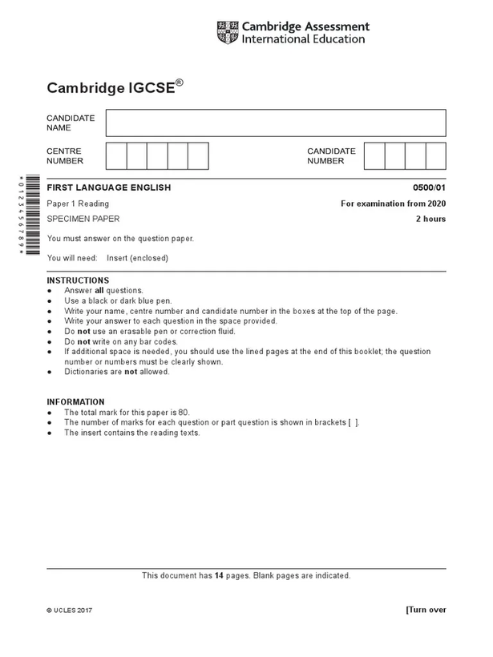











LO: To Consolidate Descriptive Writing Skills

Slide 2
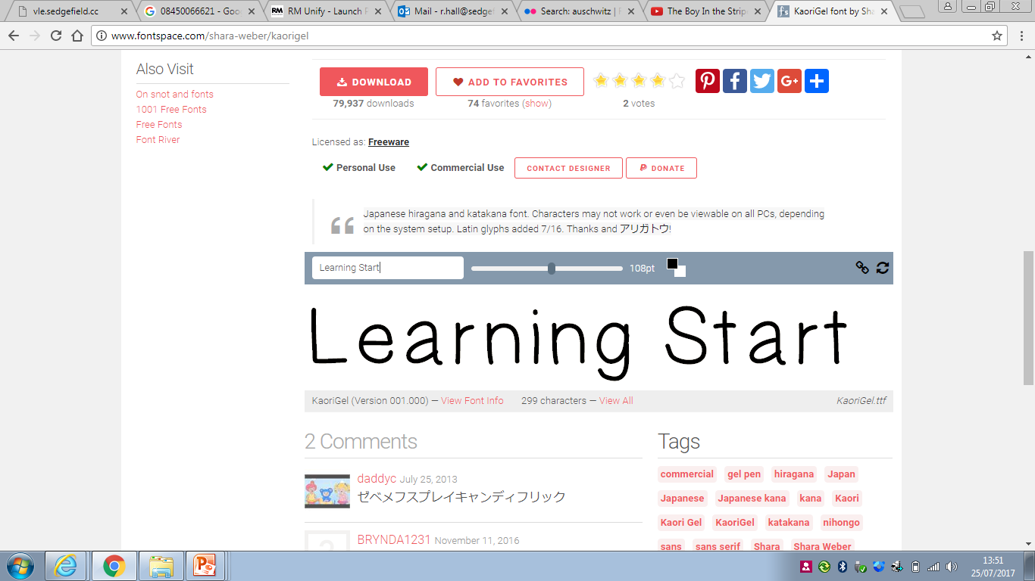

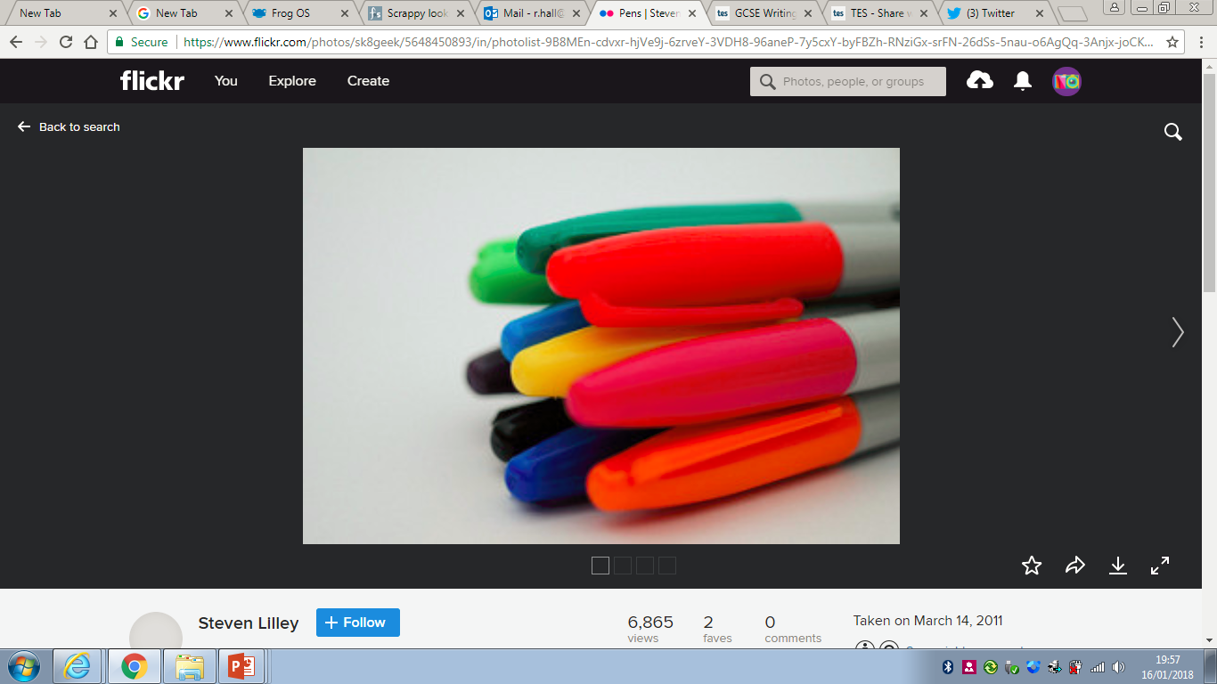
5 Minute Writing Challenge
Apricot
First sentence should begin with a preposition
Streaks
Translucent
Include a one line paragraph
Shimmering
Haze
Third sentence should begin with an adverb
Flare
Blush
Simile for a flower.
Describe a taste.

Slide 3
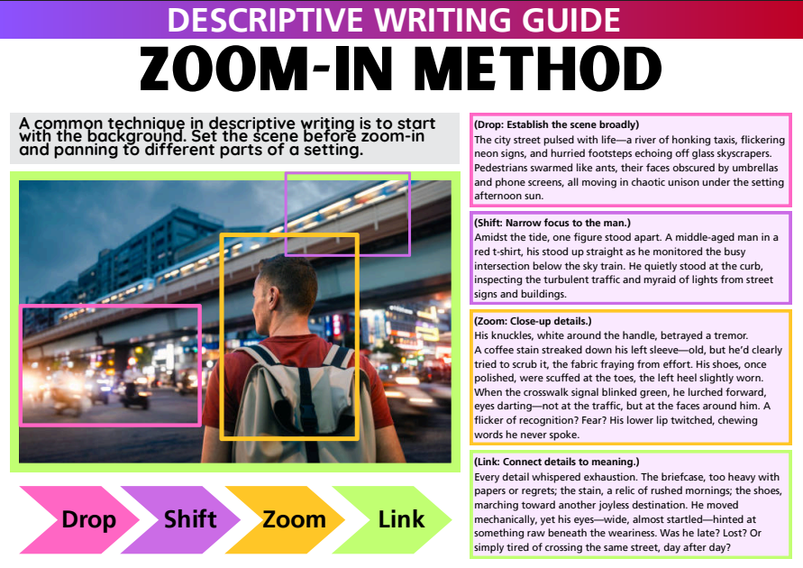
Start Big!
Set the Scene!
Then slowly zoom in

Slide 4

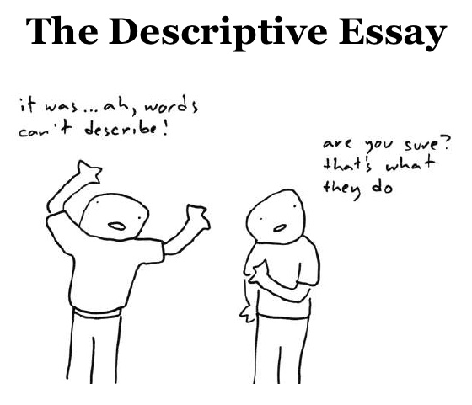
DESCRIPTIVE WRITING: Remember the “ZOOM in” structure
There is no “one method” or “right way” to structure a descriptive response but today I will guide you through one potential option.
This comes from the American method of the ‘descriptive essay’.
The first thing you need to do is come up with a ‘thesis statement’ or a dominant impression.
This is the overall mood/feeling/vision that you want to communicate throughout.
The dominant impression is a basic idea or theme that a writer utilises to set the scene and express a more complex start to a story’s construction.
A city, for example, can be described as exciting or scary, or with a variety of vocabulary depending on carefully chosen words and expressions with figurative language. Elements of the weather, pathetic fallacy can be woven in to further establish the semantic field / tone / mood as well.

Slide 5
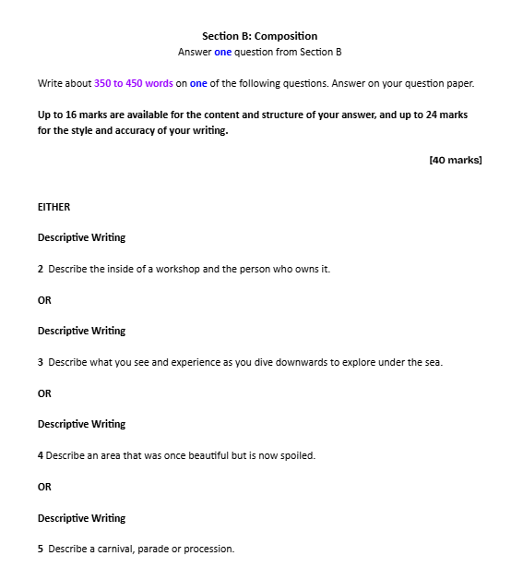
Guiding Prompt provided on Question Paper
Previously…

Slide 6
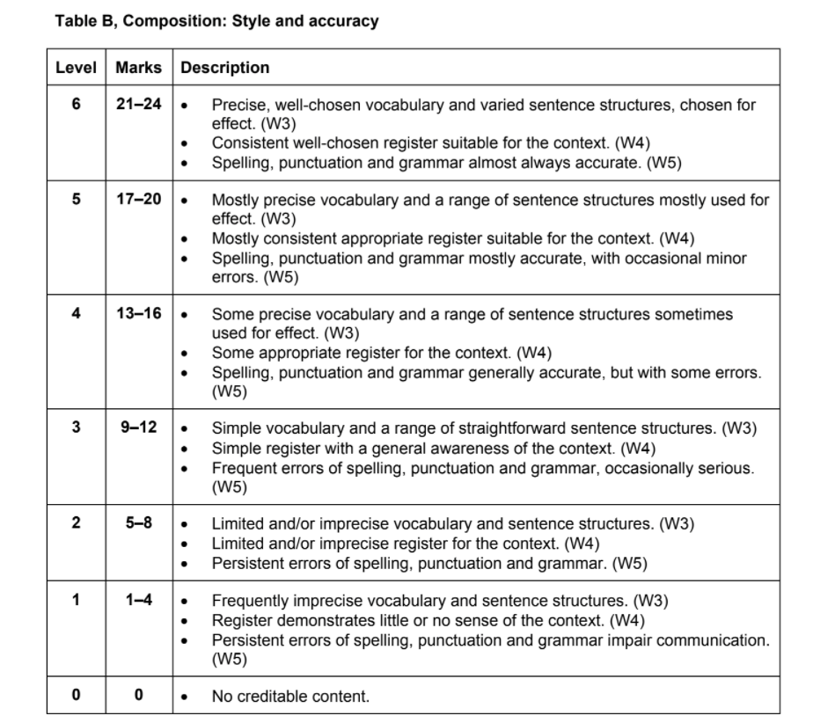
Previously…
Notes:
2 mins to show and focus more on this next lesson

Slide 7
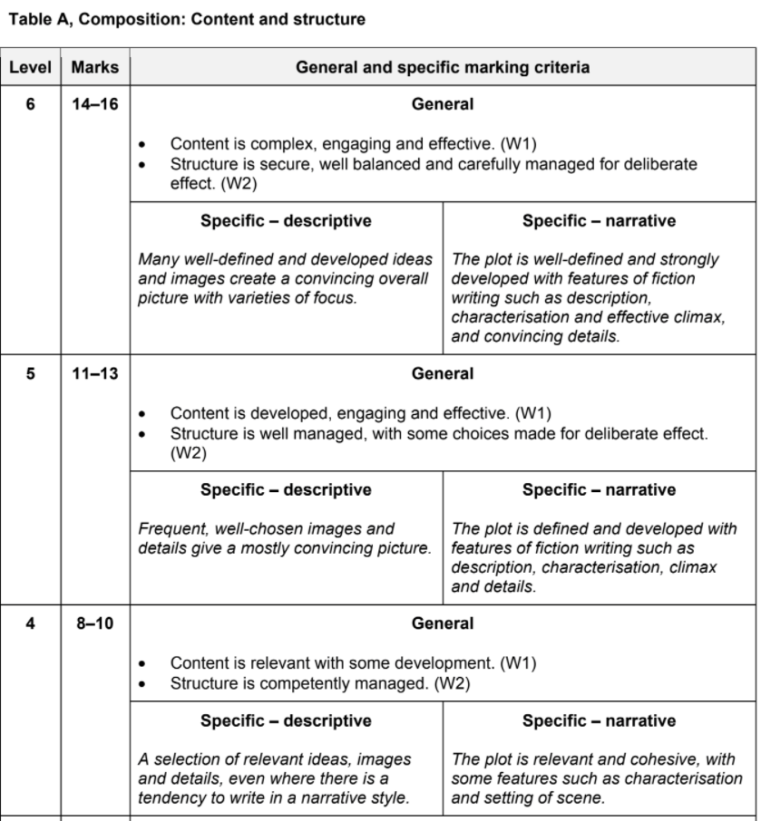
Previously…

Slide 8

RULES OF THIS TASK!
Make up your own names! Do not use characters names from the scenes!
Write in 3rd Person this time!
5 Minute Descriptive Starter!
Write your introduction!
Bullet point your following paragraphs!
Remember the methods!
Dominant Impression
Zoom structure
Show through vivid imagery

Slide 9
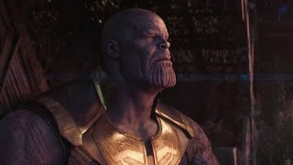
SUNSET - DESCRIPTIVE

Slide 10






“He looks like a purple thumb”
Pencils and pens at the ready…
Set the scene!
Dominant Impression
1st paragraph
Start Zooming In!

Slide 11
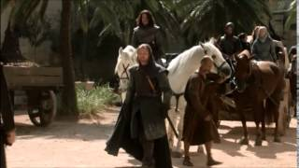
PROCESSION - DESCRIPTIVE

Slide 12



Pencils and pens at the ready…
Set the scene!
Dominant Impression
1st paragraph
Start Zooming In!

Slide 13
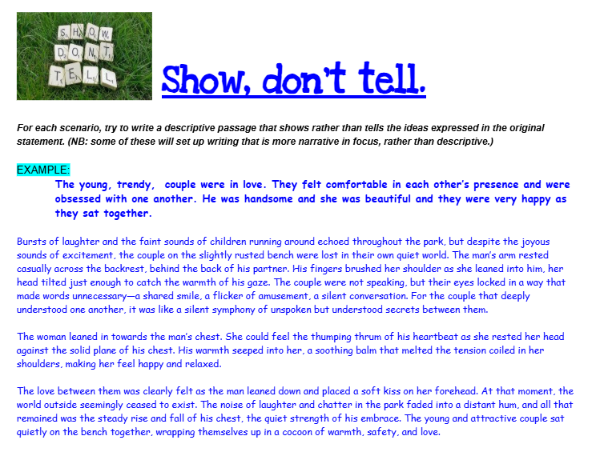
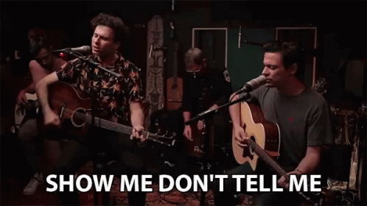
SHOW, DON’T TELL!!! Finish off your descriptive writing starters!
Have a go at writing some short descriptions from the previous question prompts! Pick one and finish writing it!
Remember the methods!
Dominant Impression
Zoom structure
Show through vivid imagery

Slide 14
Mr Shen Example:
The loud rambunctious laughter and cheers of the crowd echoed around the carnival. A giant parade of various iconic cartoon characters went down the central street inside the carnival. The carnival venue was enormous. It was almost like its own private island, similar to that of the giant Disney Land theme park in Hong Kong.
Following the dressed up cartoon characters was a giant procession of the carnival parade’s orchestral band. Men and women with giant top hats, brass instruments, and large drums marched on behind.
Previously…

